Slide 1
AI AND CYBER – A TALE OF TWO RISKS
Nick Gibbons, Legal Director nick.gibbons@clydeco.com

Slide 2
AI, AI Risk & Insurance
AI is not simply another cyber issue,
AI requires different governance,
different legal skills,
different underwriting,
and ultimately different insurance products.
The internet changed how information moves.
AI changes how decisions are made.

Slide 3
Cyber And AI – Not Very Close Relations
The word "cyber" describes issues and events on the internet
and computer networks connected by it.
The internet is a means of communication and an information store that
can be searched.
In October 1969 the first Internet message was sent from computer
science Professor Leonard Kleinrock's laboratory at UCLA to a computer at
the Stanford Research Institute
Tim Berners Lee launched the worldwide web -
what most people sall the internet - in 1991

Slide 4
Cyber And AI – Not Very Close Relations
AI is the field of computer science focused on creating machines or software that can
perform tasks that typically require human intelligence.
In 1950 Alan Turing published "Computing Machinery and Intelligence" and
proposed the Turing Test.
In 1955, John McCarthy, a Professor of Mathematics at Dartmouth College,
decided to organize a group to clarify and develop ideas about thinking machines.
He picked the name 'Artificial Intelligence' for the new field.

Slide 5
AI and the internet – same function?
The Internet
People used the internet mainly to:
communicate,
search for information,
store information,
send emails,
browse websites,
buy products,
and access online services.

Slide 6
AI and the internet – same function?
People use AI mainly to:
generate content,
answer questions,
analyse information,
make recommendations,
automate tasks,
assist decisions,
predict outcomes,
and increasingly perform actions autonomously.

Slide 7
Commonly Recognised AI types
Commonly used and recognised types of AI:
Consumer Generative AI
(ChatGPT, DeepSeek, Copilot)
Enterprise AI Solutions
(Embedded Business AI Systems)
Agentic AI
(Autonomous or Semi-Autonomous AI Systems)

Slide 8
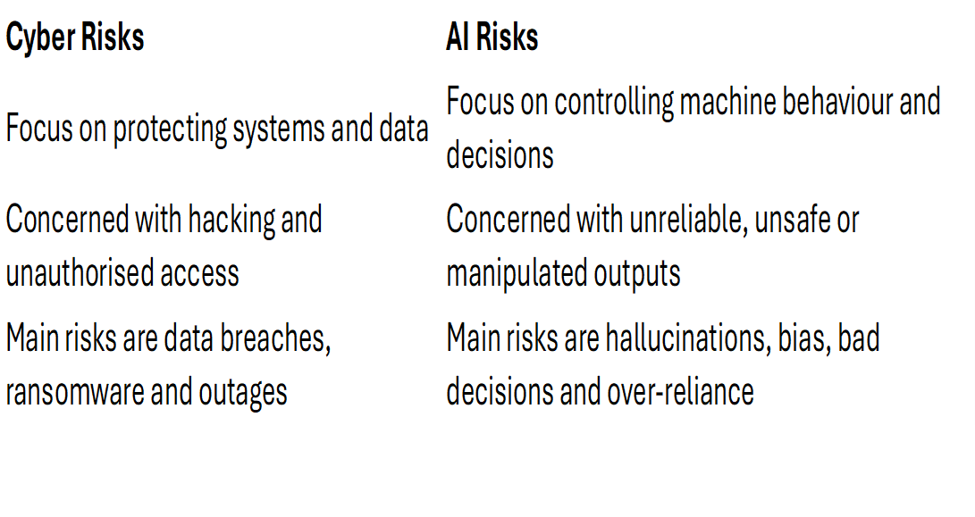
Cyber risks and AI risks
Cyber risks are primarily about protecting information.
AI risks are increasingly about controlling machine-generated
reasoning and decision-making.

Slide 9
Cyber risks and AI risks
Cyber Risk Examples
A ransomware attack encrypts a company’s servers and demands payment.
Hackers steal customer credit card and personal data from a database.
An employee clicks a phishing email and credentials are compromised.
A law firm suffers an email account takeover exposing confidential correspondence.
A hospital’s systems are disabled by malware, preventing access to records.
A cloud provider outage causes business interruption across multiple companies.
Criminals gain unauthorised access to payroll systems and divert payments.
A hacker breaches a network firewall and steals stored intellectual property.
Key Feature of Cyber Risk
The system or data is attacked, accessed or disrupted.

Slide 10
Cyber risks and AI risks
AI Risk Examples
An AI legal assistant hallucinates non-existent legal authorities.
An underwriting AI systematically misprices risks due to biased training data.
A medical AI generates unsafe treatment recommendations.
An AI recruitment tool discriminates against certain applicants.
An AI chatbot is manipulated into revealing confidential information.
An organisation becomes operationally dependent on AI outputs
without proper oversight.
An autonomous AI agent carries out unauthorised transactions or actions.
A company’s proprietary AI model and embedded business reasoning
are copied or extracted.
An AI system produces misleading financial or compliance advice relied upon
by staff or customers.
An AI workflow system behaves unpredictably after a model update
Key Feature of AI Risk
The AI behaves incorrectly, unpredictably or manipulatively —
even without a traditional cyber breach.

Slide 11
Cyber Claims and AI Claims – more of the same or different ballgame
Typical Third-Party Cyber Claims
(Primarily Data Breach and Network Security Claims)
Claims arising from theft of personal data –Regulatory investigations and fines
Failure to protect customer information -GDPR/DPA/MPI/BOC
Privacy and confidentiality claims
Ransomware and extortion losses
Business interruption caused by network outages
Claims following phishing or payment diversion fraud
Failure of cyber security systems and controls
Data restoration and incident response costs
Third-party claims arising from malware or unauthorised access
Core Nature of Cyber Claims
Loss caused by breach, intrusion, theft or disruption of information systems.

Slide 12
Cyber Claims and AI Claims – more of the same or different ballgame
Typical Third-Party AI Claims
(AI Liability and AI Governance Claims)
Claims arising from hallucinated or false outputs
Negligent AI-generated advice or recommendations
Bias and discrimination claims
Claims caused by over-reliance on AI outputs
Failure of AI oversight or governance
Confidential information disclosed by AI systems
Intellectual property and copyright infringement claims
Product liability claims involving autonomous or AI-enabled systems
Regulatory investigations into AI use or governance failures
Claims arising from manipulation of AI behaviour or outputs
Financial loss caused by AI-generated decisions
Professional negligence claims involving AI-assisted services
Claims arising from autonomous AI actions or workflows
Core Nature of AI Claims
Loss caused by the behaviour, outputs, decisions or actions of AI systems —
even where no traditional cyber breach has occurred.

Slide 13
Déjà vu? Risks Associated with the Supply and Installation of AI ERP Solutions
Project and Implementation Risk
Risks Associated with the Supply and Installation of AI ERP Solutions
Project and Implementation Risks
Failed or delayed implementation
Cost overruns and scope creep
Poor integration with existing systems
Inadequate testing and deployment
Dependence on third-party AI providers
Business disruption during implementation

Slide 14
Déjà vu? Risks Associated with the Supply and Installation of AI ERP Solutions
Contractual and Liability Risks
Vendor liability exclusions and low liability caps
Unclear responsibility for AI-generated decisions
Reliance on third-party foundation models
Disputes over performance expectations and AI accuracy
Professional negligence and product liability exposure
Regulatory investigations and compliance failures

Slide 15
The law governing AI use – not just GDPR and privacy
Cyber risk has largely developed around:
data protection,
network security,
operational resilience,
and breach management.
Lawyers and insurers have therefore focused on :
UKGDPR
Data Protection Act
Misuse of Private information
Breach of Confidence

Slide 16
The law governing AI use – not just GDPR and privacy
Modern AI and Cyber Regulation
Frameworks such as:
Digital Operational Resilience Act,
NIS2 Directive,
the EU AI Act,
trade secret law,
intellectual property law,
and operational resilience regulation
extend far beyond personal data.
The concern increasingly includes:
proprietary business data,
operational systems,
AI models,
algorithms,
business logic

Slide 17
The law governing AI use – not just GDPR and privacy
A great deal of AI liability may ultimately develop through common law governing :
negligence,
Bias
professional negligence
Breach of intellectual property rights
Theft of commercial information /R &
breach of contract,
product liability,
fiduciary duties,
misrepresentation,
and duties of care.
Courts will increasingly ask:
Was reliance on the AI reasonable?
Was human oversight adequate?
Was the AI system properly governed?
Were risks foreseeable?
Was the use of AI explained appropriately?
Were safeguards adequate?
Who is responsible for autonomous outputs?
These are classic common law questions applied to new technology.

Slide 18
Governance and AI
Internal Business Policies and Procedures Need to Adapt for AI
Traditional policies focused mainly on:
IT security,
acceptable use,
data protection,
access controls,
cyber security,
and document retention.
GDPR compliance involves:
Privacy policies
A data protection officer
Information security measures complying with UKGDPR/DPA 2018
comprising adequate technical measures and staff trainng focused on UKGDPR
And cyber security
Policies governing data minimisation and dealing promptly with DSARs
Staff training around the use and misudse of personal data
Personal data breach reporting

Slide 19
Governance and AI
Businesses Need Dedicated AI Governance Policies
Organisations increasingly need policies covering:
approved AI use,
prohibited AI use,
human oversight requirements,
AI-generated content review,
escalation procedures,
and accountability for AI-assisted decisions.
Employees must understand:
when AI can be used,
how outputs must be checked,
and when human judgement must override the system.

Slide 20
Governance and AI
AI Use Policies
Businesses need clear rules on:
use of public AI tools,
uploading confidential information,
use of customer data,
use of AI-generated advice,
and use of AI in regulated or sensitive activities.
Without controls, staff may unknowingly expose:
confidential information,
intellectual property,
commercially sensitive material,
or privileged documents.

Slide 21
AI information security – a step beyond cyber
Traditional cyber security is designed mainly to:
protect networks,
protect systems,
prevent unauthorised access,
and secure data and infrastructure.
Organisations rely on:
Cyber security experts
Cyber Essentials
ISO certification
UKGDPR Aand othrer regulatory requirements
Insurance guidance and policy requirements

Slide 22
AI information security – a step beyond cyber
AI systems create additional risks that traditional cyber controls
alone do not address.
AI security must also protect against:
manipulation of AI behaviour,
prompt injection attacks,
hallucinations and unsafe outputs,
disclosure of confidential information by the AI itself,
poisoning of training data,
corruption of AI reasoning,
over-reliance on AI-generated decisions,
and autonomous or unpredictable system behaviour.

Slide 23
AI information security – a step beyond cyber
An AI system may therefore be:
fully cyber secure,
fully patched,
and protected against hackers,
yet still:
generate dangerous outputs,
disclose sensitive information,
make flawed decisions
Traditional cyber security protects:
systems, networks and information.
AI information security must additionally protect:
machine reasoning, outputs, behaviour and decision-making processes.

Slide 24
AI information security – a step beyond cyber
AI security requires:
behavioural controls,
governance controls,
human oversight,
explainability,
output monitoring,
and AI-specific risk management,
in addition to traditional cyber security measures.

Slide 25
Why traditional cyber expertise is not enough for AI
Cyber law developed around:
hacking,
data breaches,
ransomware,
privacy,
network security,
and operational resilience.
The core issues were:
unauthorised access,
loss of data,
system compromise,
and regulatory reporting.

Slide 26
Why traditional cyber expertise is not enough for AI
AI Creates Additional and Different Legal Problems
AI disputes wil increasingly involve:
ERP AI solution issues
hallucinated outputs,
unreliable recommendations,
autonomous actions,
bias and discrimination,
manipulation of AI behaviour,
explainability failures,
and organisational reliance on machine-generated reasoning.
These are not classic cyber problems.

Slide 27
Why traditional cyber expertise is not enough for AI
AI Requires Additional/Different Legal Skills
In addition to cyber expertise AI lawyers will need a clear understanding of:
professional liability,
product liability,
governance,
operational decision-making,
intellectual property,
contract allocation of risk,
technology implementation disputes,
regulatory governance,
and evidential issues involving probabilistic systems

Slide 28
Why traditional cyber expertise is not enough for AI
This matters because insurers may wrongly assume:
existing cyber panels,
cyber questionnaires,
and cyber policy structures
are sufficient for AI risk.
In reality, AI claims may require:
different experts,
different underwriting,
different governance frameworks,
and different legal analysis.

Slide 29
AI risks, cyber insurance and “Secret” AI cover
AI Risk Is Not Properly Covered by Traditional Cyber Insurance.
Traditional cyber insurance was designed mainly to cover:
data breaches,
ransomware,
hacking,
network interruption,
cyber extortion,
and privacy liability.
AI risks are different and often arise:
without hacking,
without unauthorised access,
and without a traditional cyber event

Slide 30
AI risks, cyber insurance and “Secret” AI cover
Rather than traditional cyber events, AI losses may instead involve:
hallucinated outputs,
flawed recommendations,
biased decisions,
autonomous actions,
disclosure caused by AI behaviour,
governance failures,
and over-reliance on AI systems.

Slide 31
AI risks, cyber insurance and “Secret” AI cover
Many AI risks may fall:
partly within cyber insurance,
partly within professional indemnity,
product liability,
D&O,
technology E&O,
or general liability policies.
However, these policies were generally:
not designed specifically for AI,
do not properly address AI exposures,
and may contain significant uncertainty and coverage gaps.

Slide 32
AI risks, cyber insurance and “Secret” AI cover
Current problems include:
proposal forms asking cyber rather than AI governance questions,
policy wordings focused on breaches and network security,
exclusions that may unintentionally remove AI-related cover,
uncertainty over whether AI failures constitute cyber events,
overlap between cyber, PI and product liability policies,
silent AI exposure,
and aggregation risks not properly modelled.

Slide 33
AI risks, cyber insurance and “Secret” AI cover
Many insurers are therefore already carrying AI exposure indirectly,
but:
without dedicated underwriting frameworks,
without clear policy intent,
and without AI-specific pricing or controls.
AI risk is already entering the insurance market
through existing policies —
but often without being properly identified, underwritten
or addressed

Slide 34
A Tale of Two Risks : Conclusion
Cyber risk and AI risk are related but fundamentally different.
Cyber risk focuses on protection of systems, networks and information.
AI risk focuses on machine behaviour, reasoning, outputs and decision-making.
AI can create major losses without any traditional cyber breach.
Existing cyber governance and data protection frameworks are not sufficient for AI.
AI introduces new operational, legal, governance and insurance challenges.
AI systems can be manipulated, disclose information and behave unpredictably in ways traditional systems cannot.
AI creates new forms of professional, product, regulatory and aggregation risk.
Existing insurance policies already contain AI exposure, often unintentionally.
Traditional cyber underwriting questions may not identify key AI risks.
AI requires broader legal, governance and underwriting expertise.
The market is still adapting to the distinction between information risk and decision risk.
The internet age was about information.
The AI age is increasingly about machine-influenced reasoning and decision-making.

Slide 35
A Tale of Two Risks : some final thoughts
Next thoughts and suggestions for Insurers and Underwriters:
Develop dedicated AI underwriting frameworks
Introduce AI-specific proposal form questions
Review existing cyber, PI and technology wording for AI exposure
Address silent AI exposure and aggregation risks
Develop clearer AI governance standards for insureds
Consider AI-specific exclusions, endorsements or products
Improve understanding of AI operational and behavioural risks
Expand underwriting expertise beyond traditional cyber models
Assess AI supply-chain and third-party model dependencies
Monitor evolving AI regulation and common law developments
Build multidisciplinary teams combining:
  cyber,
  technology,
  insurance,
  governance,
  IP,
  product liability,
  and AI expertise
AI should not simply be placed into the existing cyber box.
It represents a broader and fundamentally different category of risk.

Slide 36
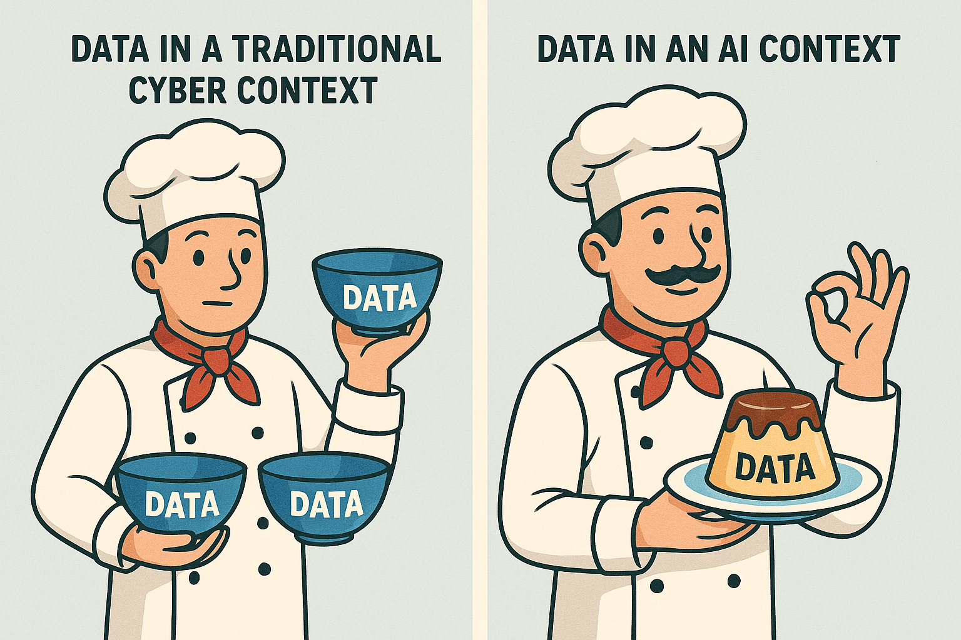
Why AI security matters
Dangers
Protection steps Law
Certifications
Hackers
Monitoring
SME challenges
Insurance
Notes:
This slide outlines what we'll cover: key risks, protection, rules, and specific concerns for small businesses.

Slide 37
ANY QUESTIONS?

